Slide 1

Instructions
by Hatem Hellal

Slide 2
Readme!
1. For the best result please make sure you have installed the libraries and downloaded all the required files like the dictionary of positive and negative words (named dictionary in the code)
2. There are two methods used in this task the wanted one and the alternative one
3. The code is commented
Thanks :)
Hatem Hellal

Slide 3
Introduction

Slide 4
Introduction
Sentiment analysis, also known as opinion mining, refers to the use of natural language processing, text analysis and computational linguistics to identify and extract subjective information in source materials.

Slide 5
CONTENT

Slide 6
Method 01:
Classical computing
Method 02
Using pre-trained model
CONTENTS

Slide 7
Method 01 :Classical computing

Slide 8

Uncomment the rows by removing the triple quotes
Run code after changing file path everytime you encounter it
Method 01
Classical Computing
Things to do

Slide 9
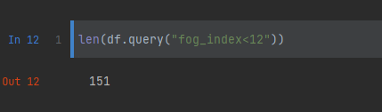
Texts for a wide audience generally need a fog index less than 12.Most of the given texts are readable.
Analysis of output1
Method 01
Classical Computing

Slide 10
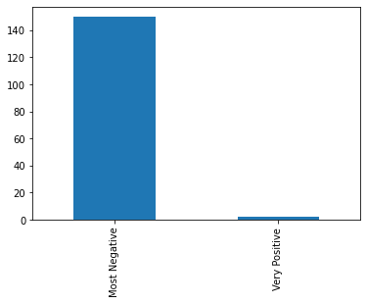
Most of texts are Most negative using classical computing
Analysis of output2
Method 01
Classical Computing

Slide 11
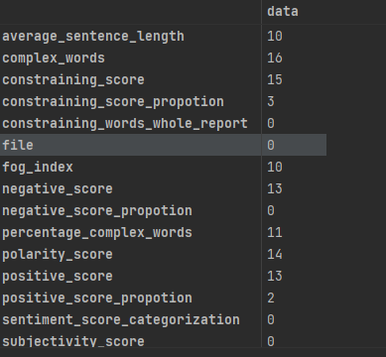
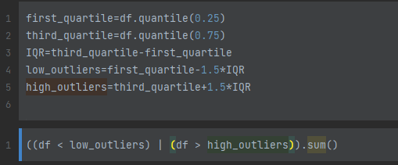
Number of outliers code->
Analysis of output3
Method 01
Classical Computing

Slide 12
Method 02 :using FinBert

Slide 13
What is FinBERT
FinBERT is a pre-trained NLP model to analyze sentiment of financial text. It is built by further training the BERT language model in the finance domain, using a large financial corpus and thereby fine-tuning it for financial sentiment classification.

Slide 14
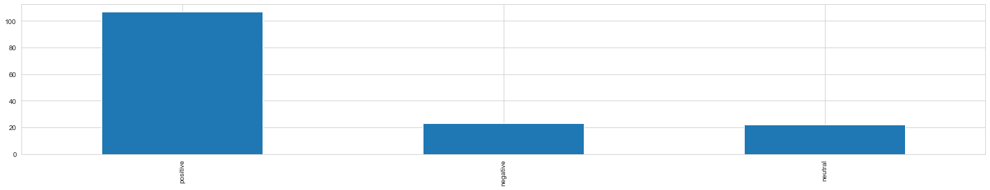
Most of predicted values are positive
Analysis of output1
Method 02
Using model

Slide 15
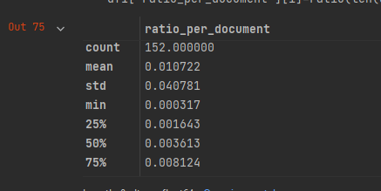
Ratio of summary per document
Analysis of output2
Method 02
Using model

Slide 16
FINAL CONCLUSIONS

Slide 17
POSITIVE
NEGATIVE
Contradiction between first and second method due to a lot of factors
_ summary length per documents(What if we add more)
_Cleaning code isn’t that efficient : It needs maybe more work.
All document are readable
As the fog_index shows that all documents are readable for a wide audience.
Cleaning
Cleaning of reports could’ve been better if they were better organized.

Slide 18
Thank You!
:)

